Slide 1

WELCOME
features
MINI PROJECT 2020
end
layout
skills
timeline
project
DESIGNED BY YASH JAISWAL
CSE - II - YEAR

Slide 2

end
skills
features
layout
timeline
project
ABOUT THE PROJECT
DOCKET
Docket is an app that enables you to easily create and save schedules, and sync them across many device. The intuitive app helps you to manage your school/university life in a organized manner. You can record homework and exam schedules.

Slide 3



1
2
3
end
Widget
Notifications
Auto Mute
features
layout
skills
timeline
project
It offers a widget mode with light and dark theme
Its notifies for lessons and next day tasks
It puts the phone on mute during the lessons

Slide 4
1
2
3
4
end
IDEA
FUNCTIONALITIES
UI FLOW
DATA BASE
features
layout
skills
timeline
project
PICKING UP AN IDEA FOR THE APP
DEFINING THE CORE FUNCTIONALITIES
PLANNING THE APP’S UI FLOW
DESIGNING THE DATA BASE

Slide 5



01
02
03
end
features
layout
skills
timeline
project
JAVA
ANDOID STUDIO
SQL
BASIC REQUIREMENT
ANDROID DEVELOPMENT
DATA BASE MANGEMENT

Slide 6
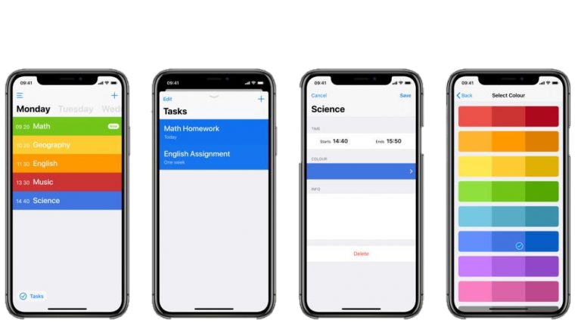
end
layout
features
skills
timeline
project

Slide 7
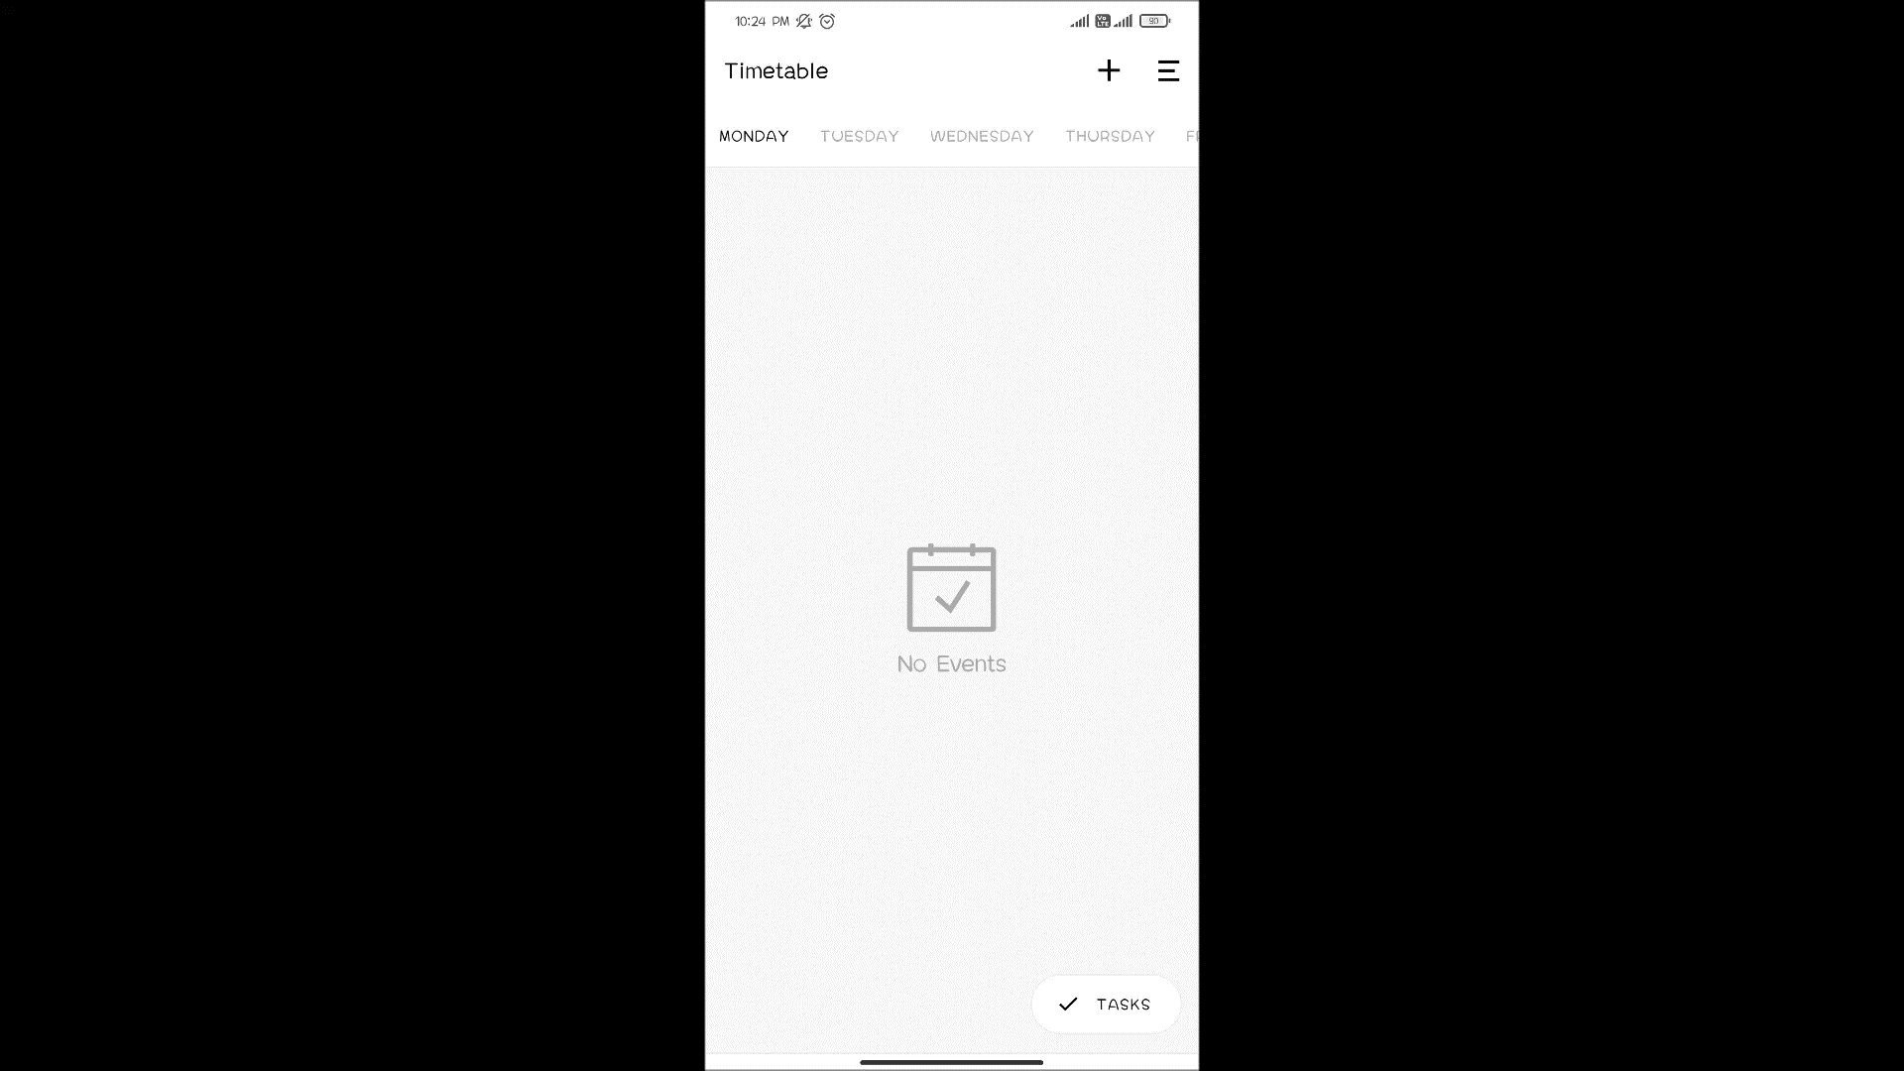

Slide 8
THANK YOU
FOR GIVING YOUR PRECIOUS TIME
end
features
layout
skils
timeline
project

